Slide 1
Sewing Pāʻū & Malo
Sewing instructions for the pāʻū & malo

Slide 2
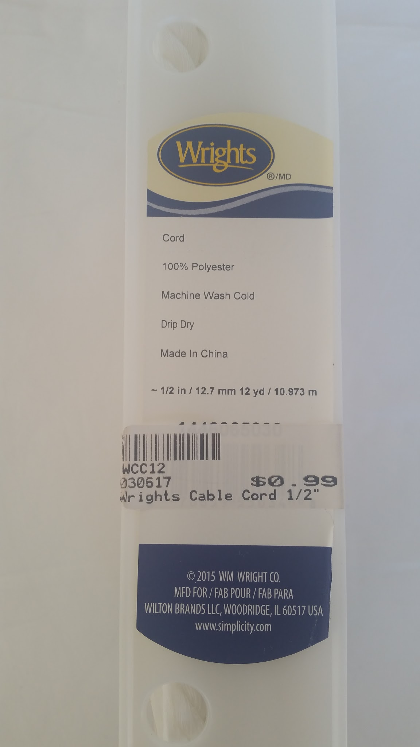
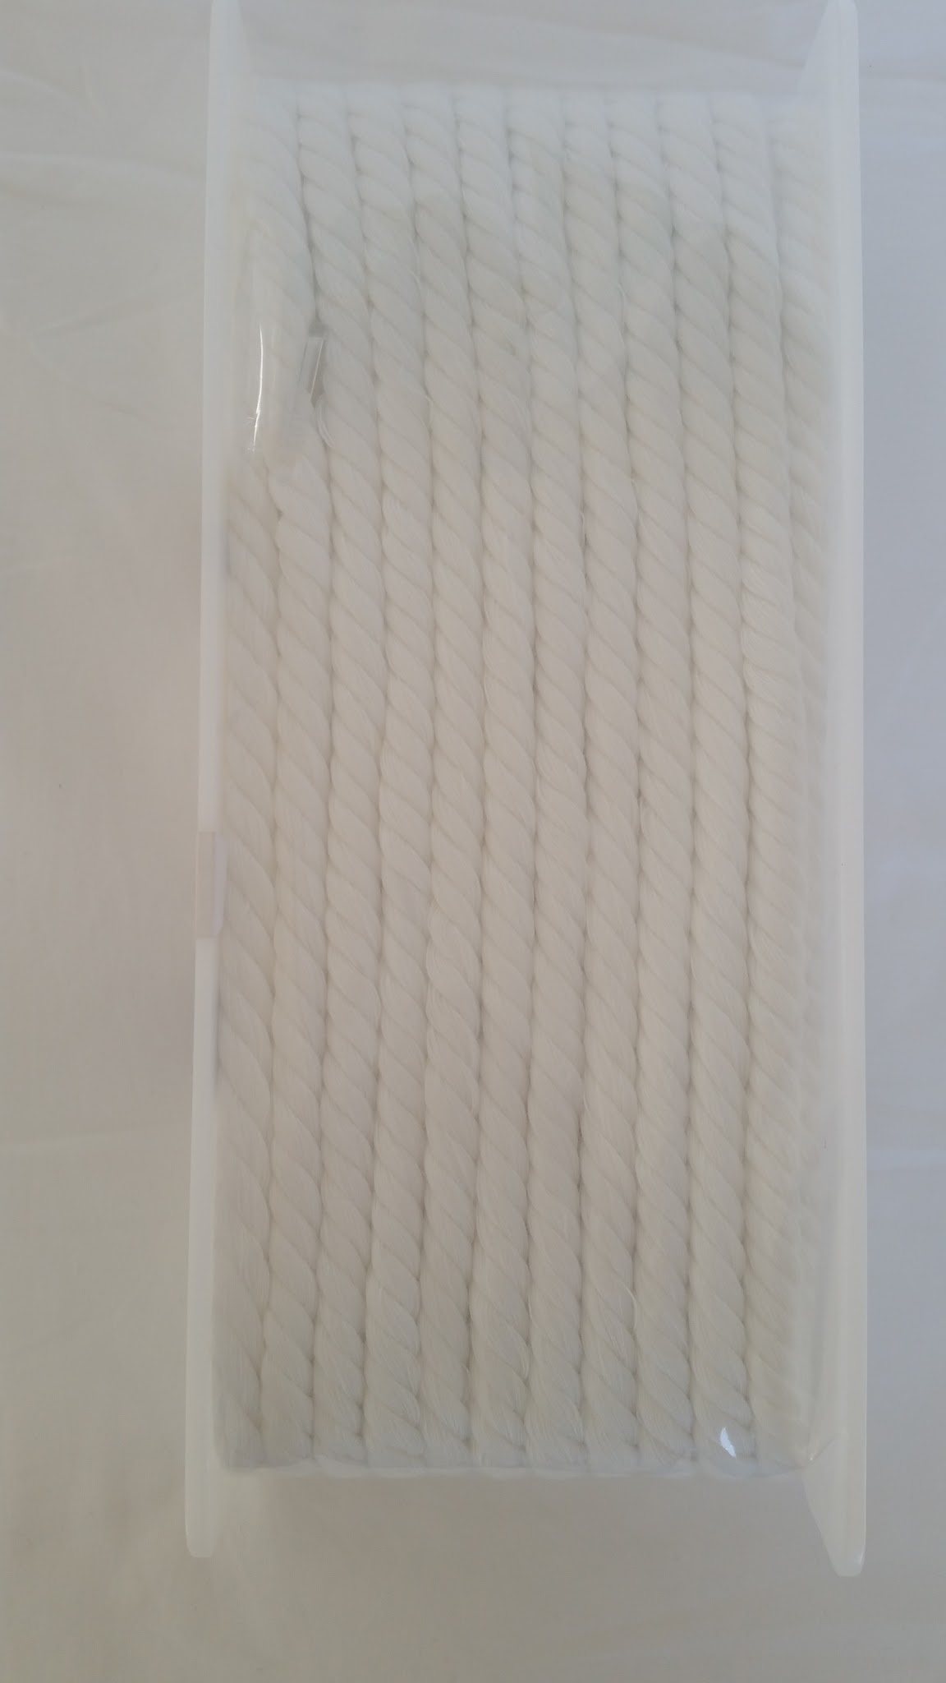
Materials Needed
4 Yards muslin
4 Cords long enough to tie around your waist, ½” width
Thread

Slide 3
Preparing Muslin
If you sew before dying fabric with ʻōlena:
Wash fabric without detergent and dry
Iron out wrinkles
Sew with yellow thread

Slide 4
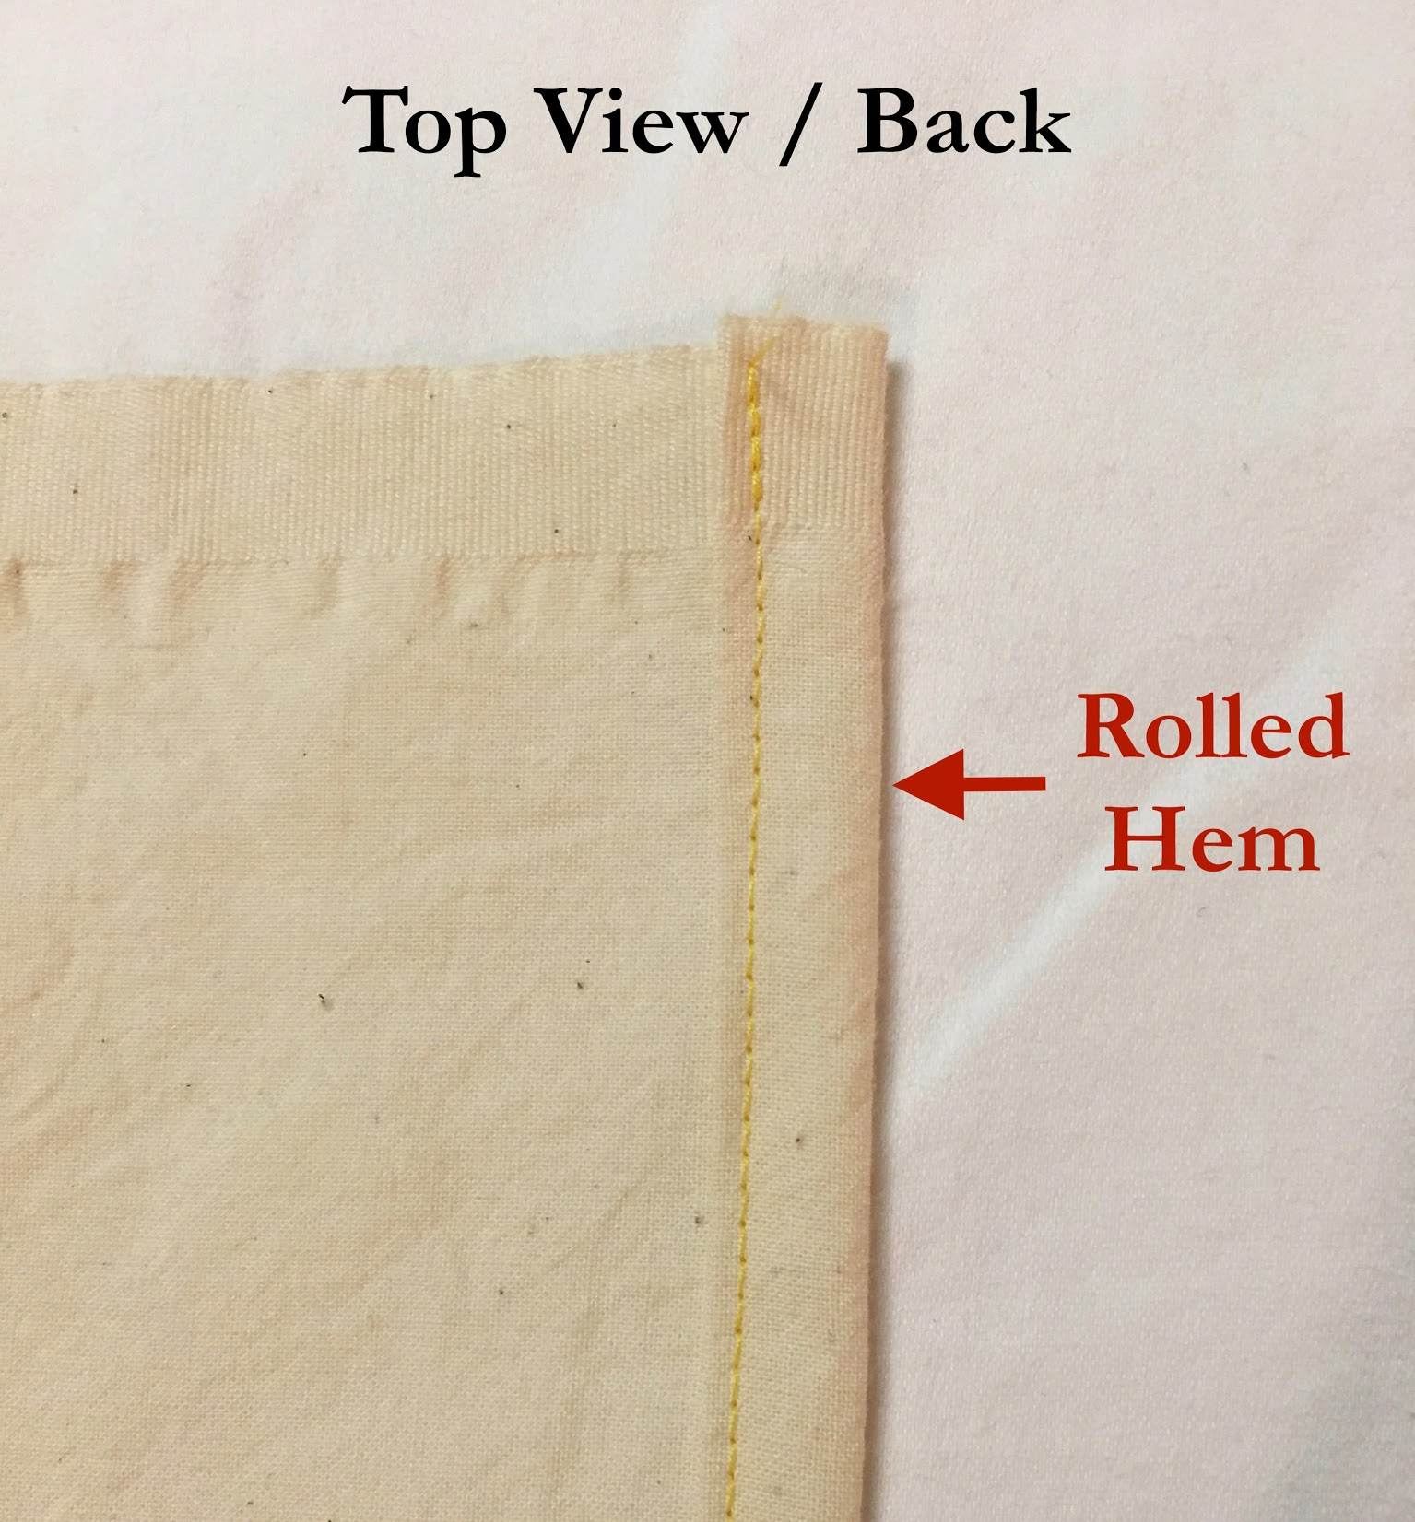
Sewing the Pāʻū
Roll hem the cut edges
4 Yards Muslin

Slide 5
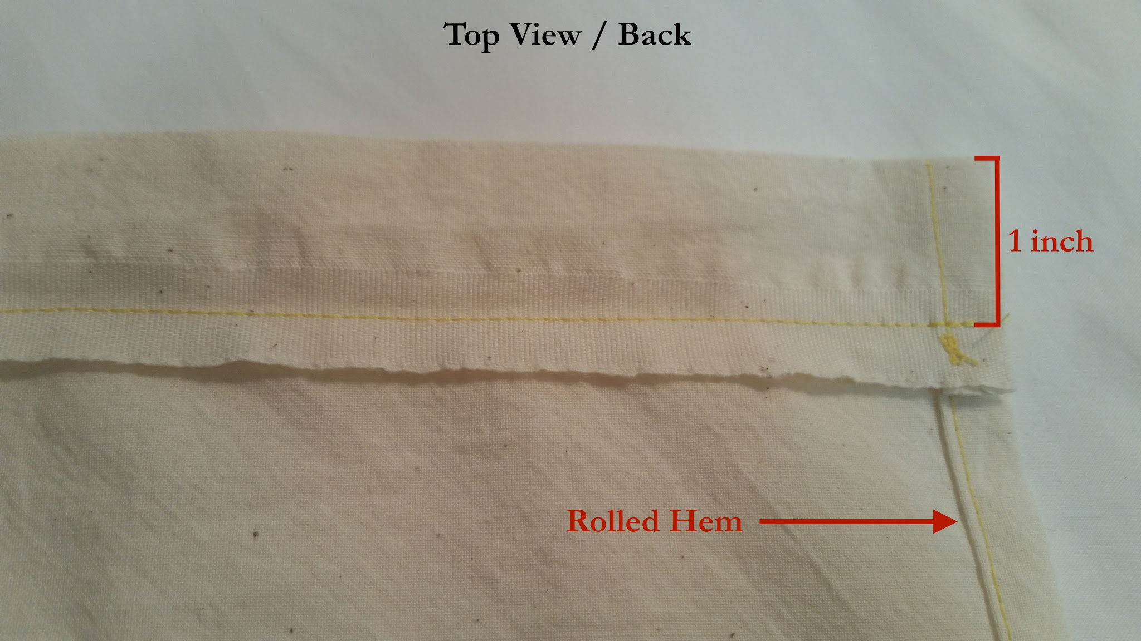
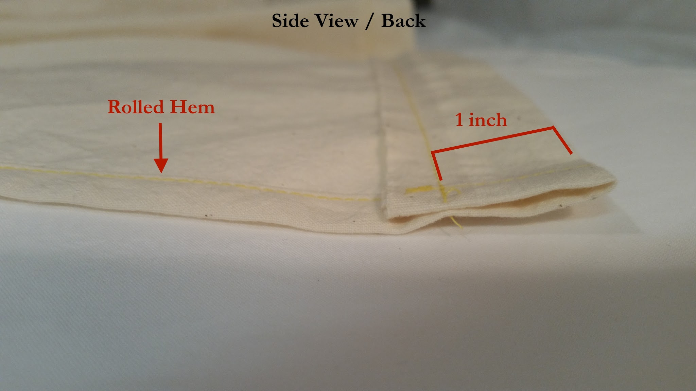
Sewing Casings
Sew a 1” casing by folding down from the top and sewing a straight line. The casing should measure 1” from the seam to the top of the pāʻū.

Slide 6
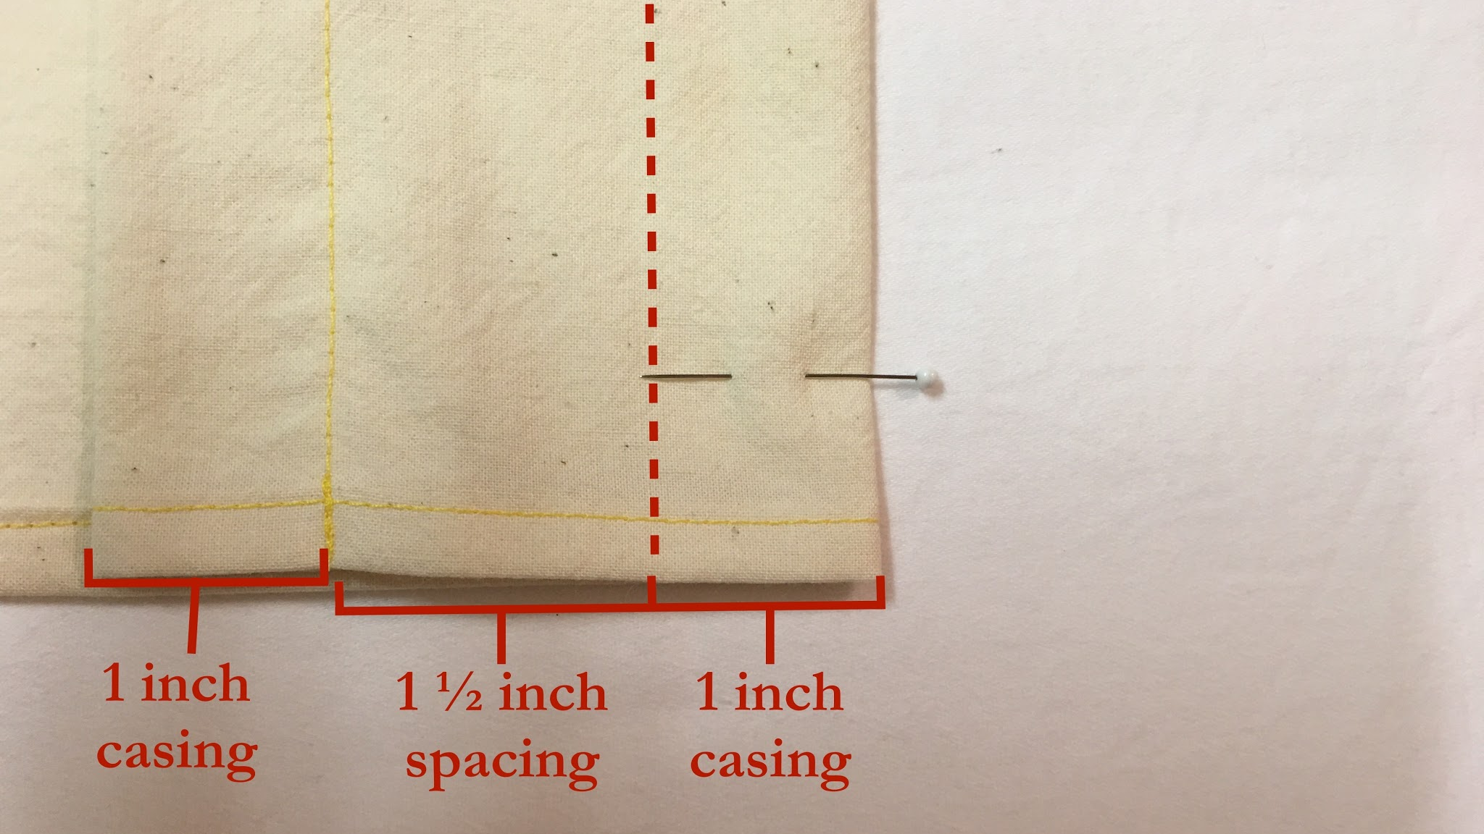
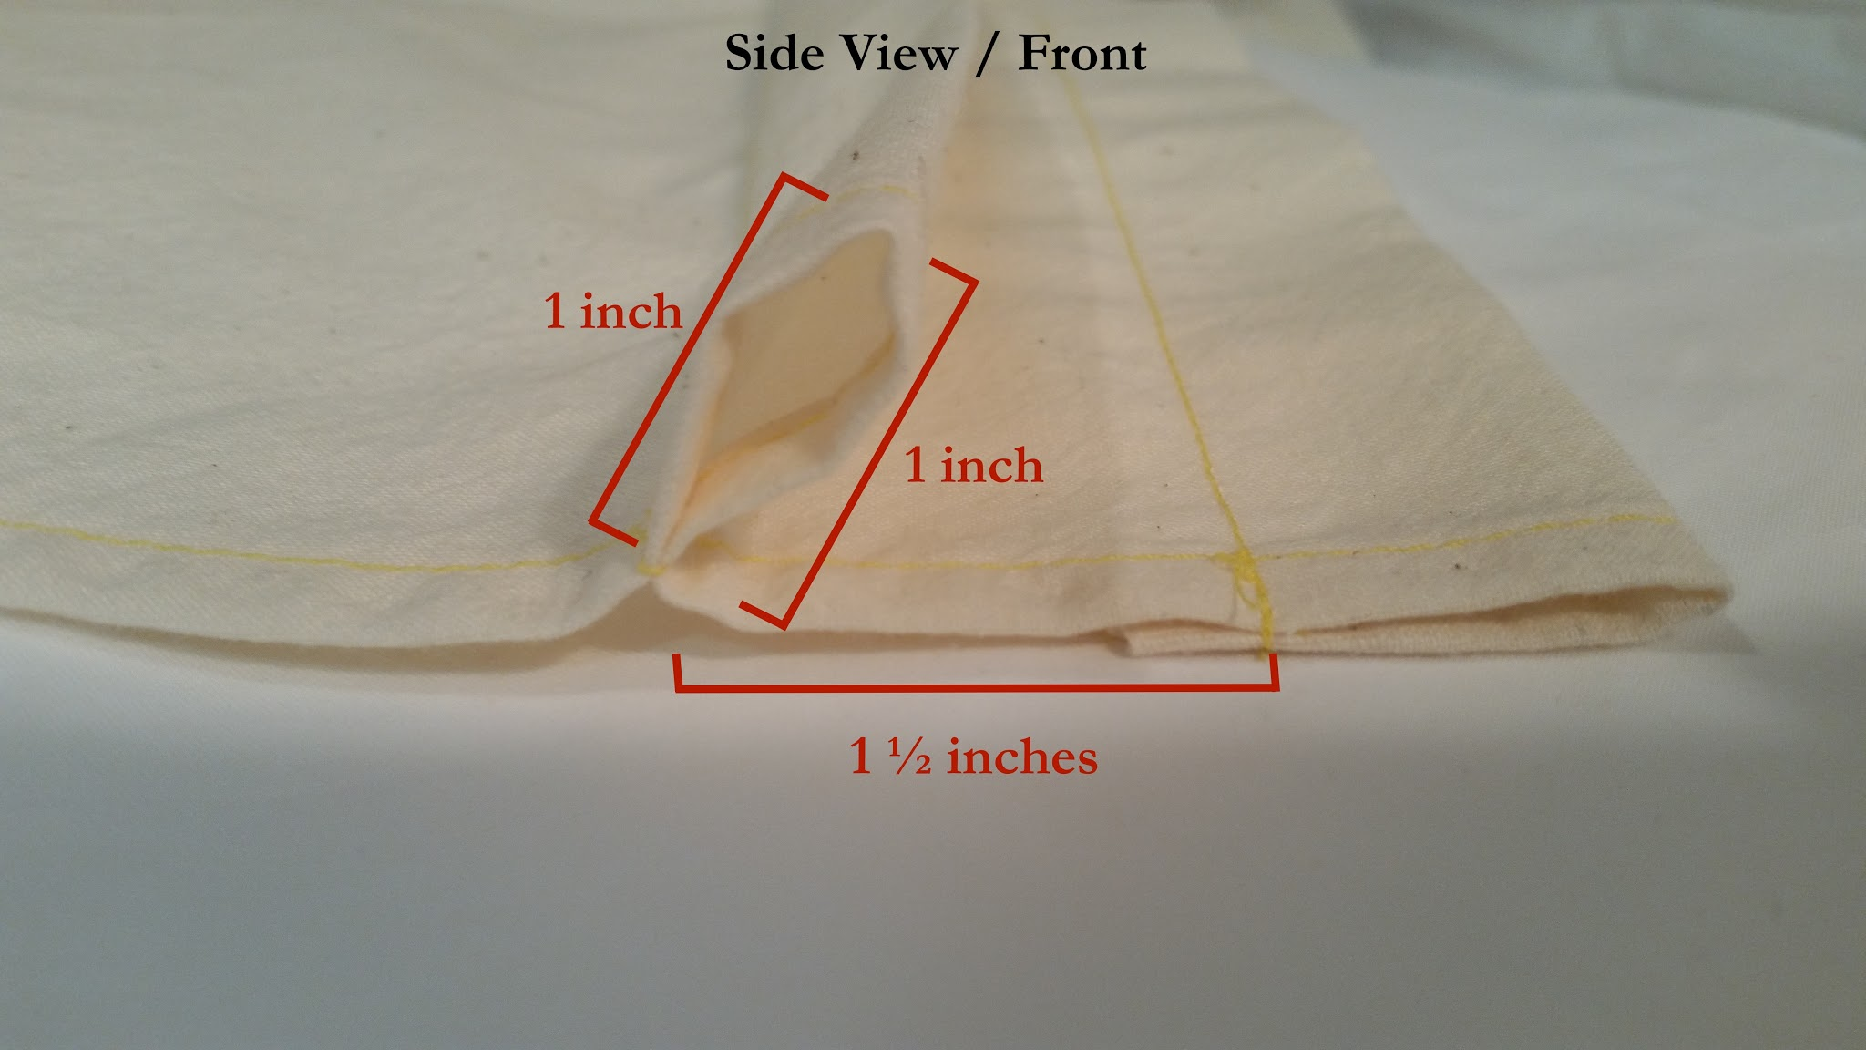
Sewing Casings
Fold the fabric down again, this time measuring 2 ½” from the bottom of the first casing. Sew a seam 1” from the top, as shown in the picture on the left.

Slide 7
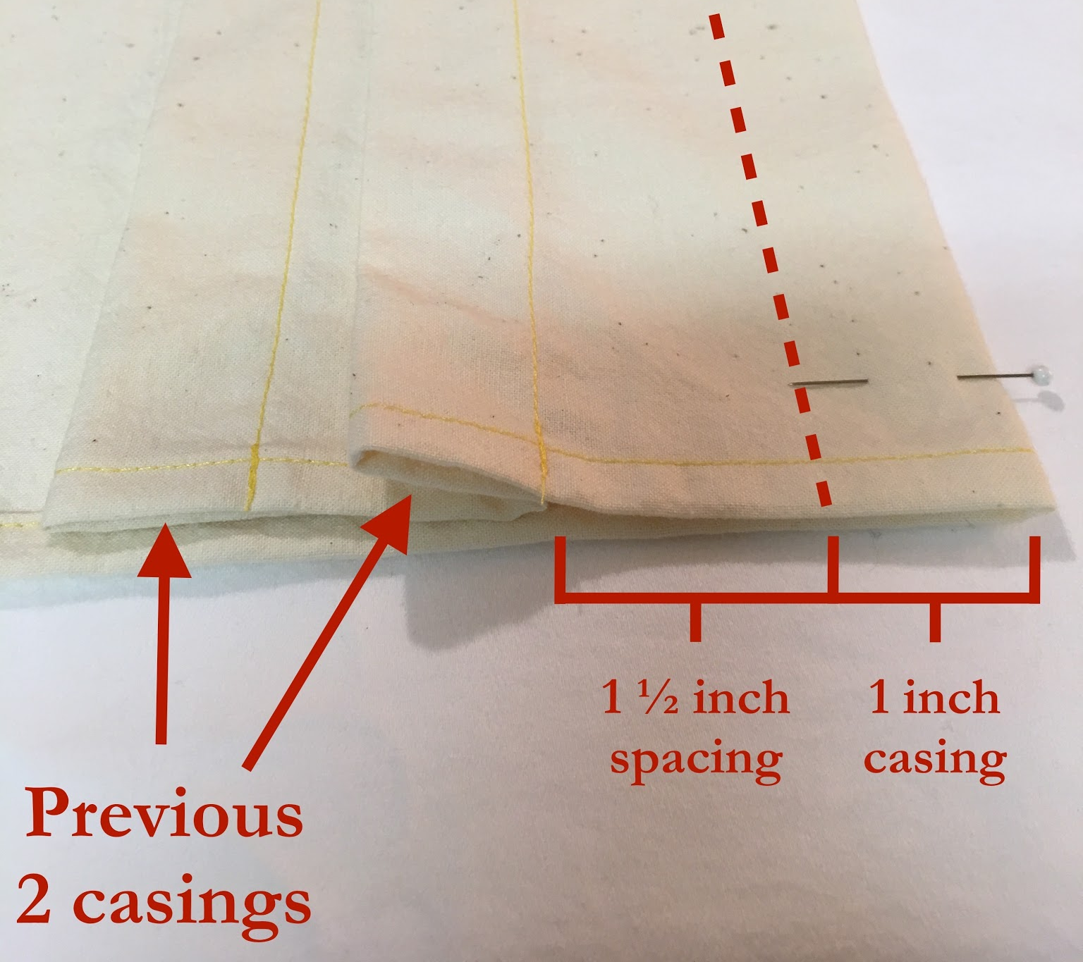
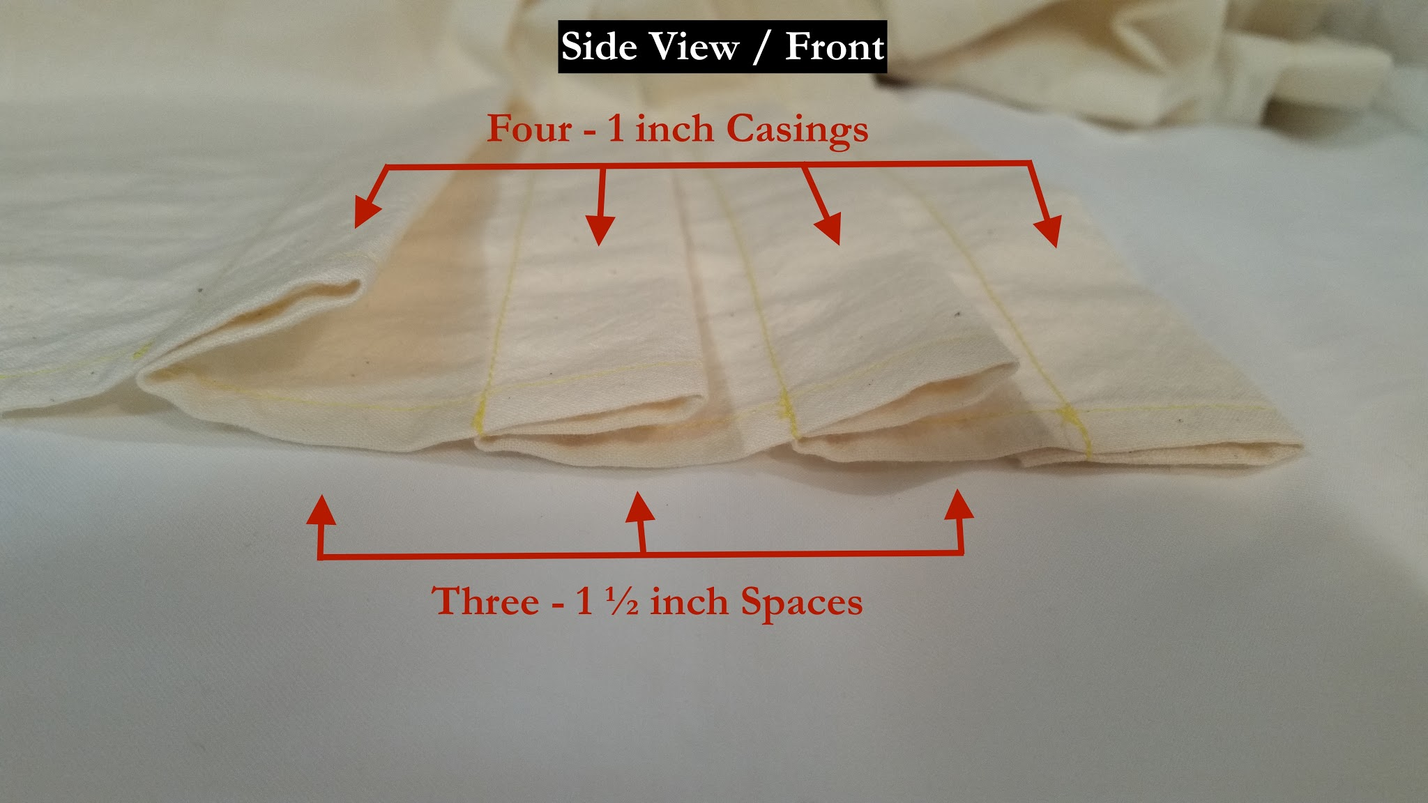
Sewing Casings
Repeat 2 more times to create 2 more casings...resulting in a total of four 1” casings, with a 1 ½” spacing between each of them.

Slide 8
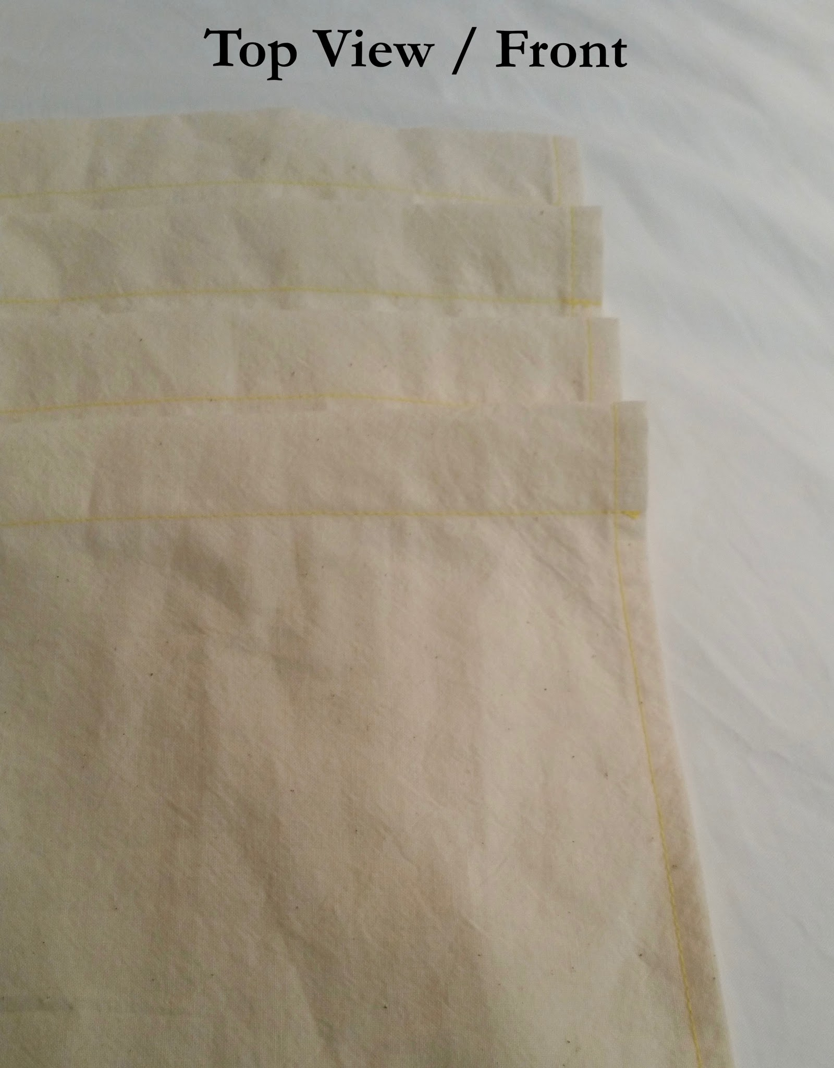
Sewing Casings
The finished casings should look like this.

Slide 9
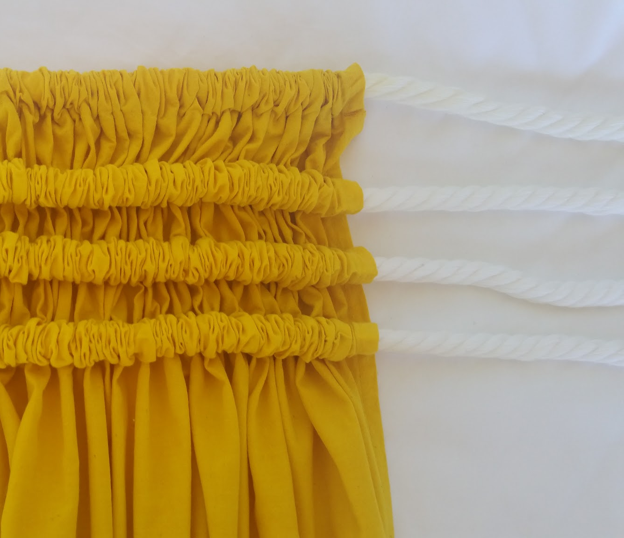
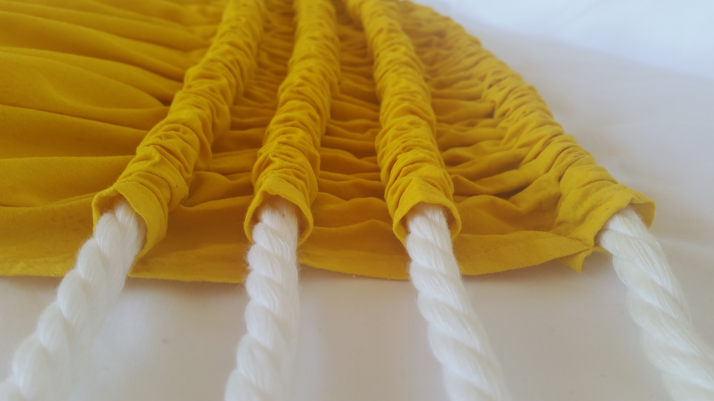
Pāʻū Dyed and Strung
Dye fabric ʻōlena
Please refer to ʻōlena dying instructions
String cords through casings

Slide 10
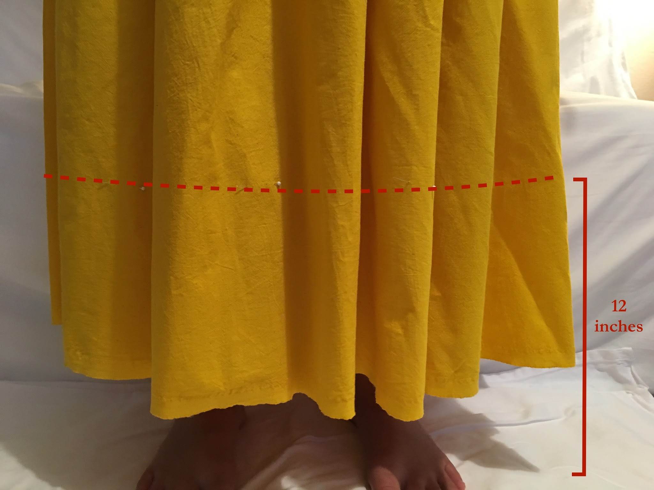
Hemming the Pāʻū
Use pins as a measurement of how far to fold up your pāʻū. Wahine will fold up so that the pau will land 12” off the floor.

Slide 11
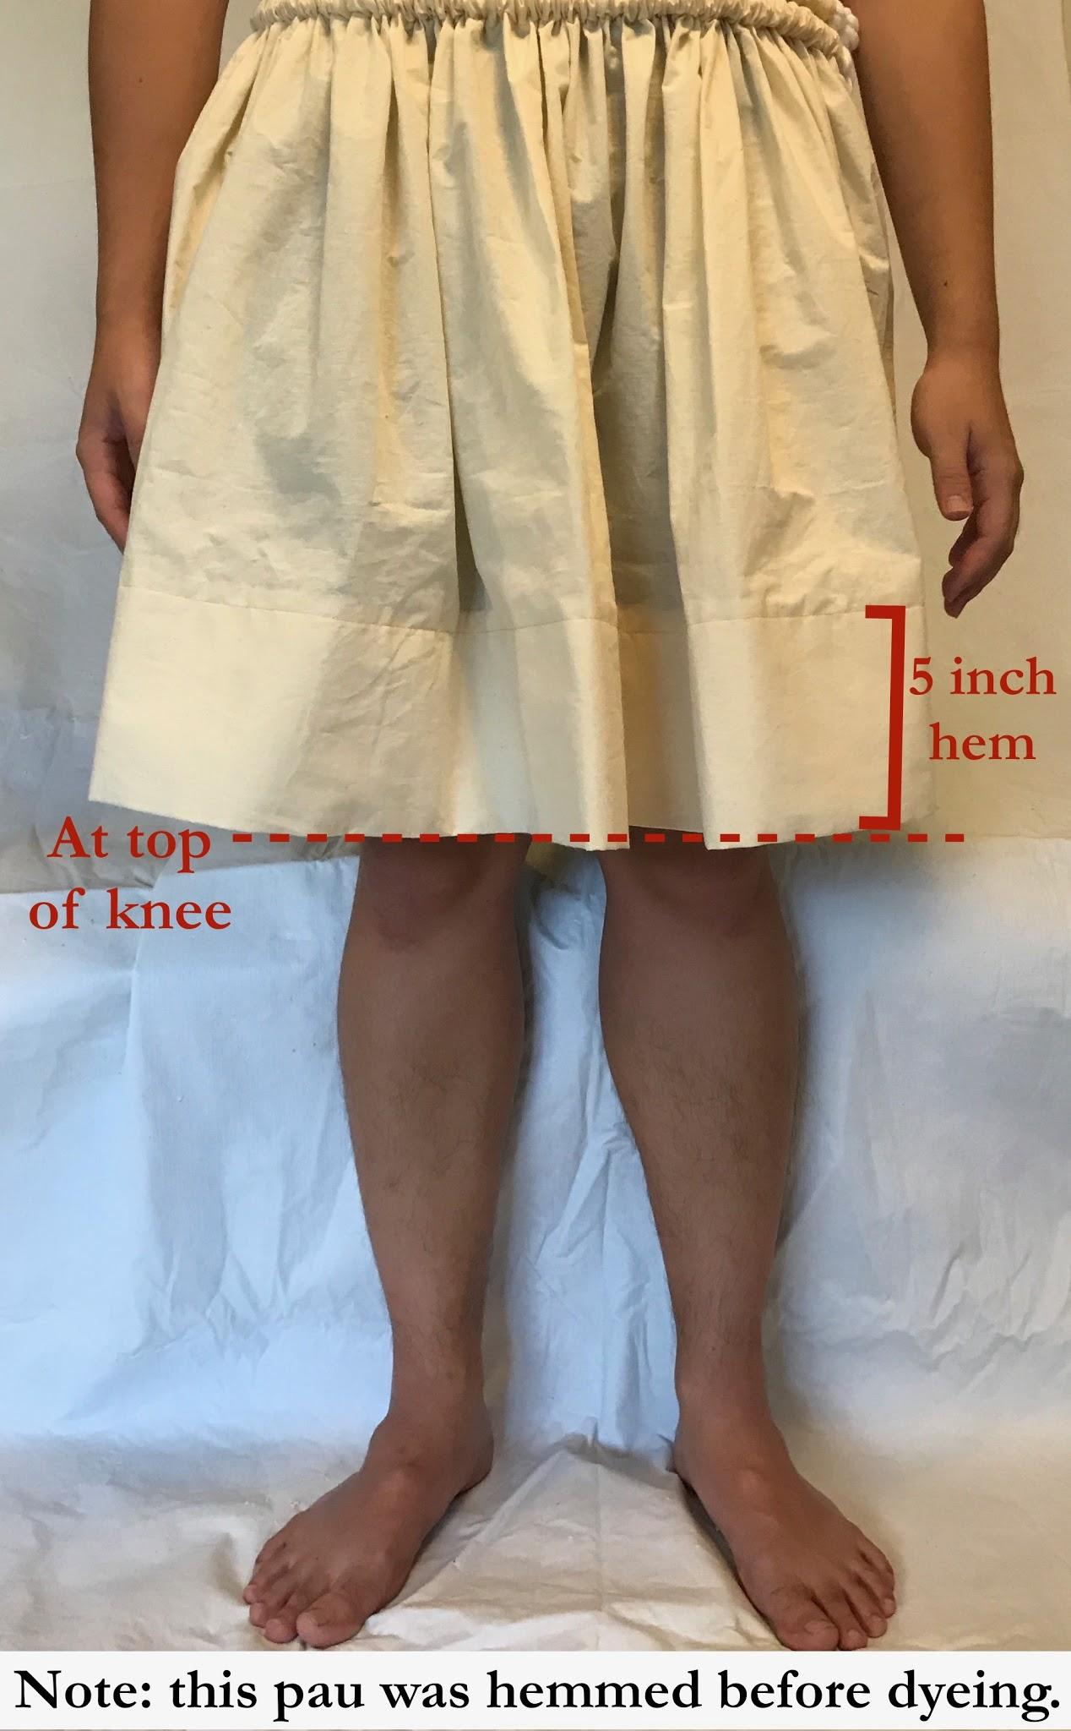
Hemming the Pāʻū
Use the pins as a measurement of how far to fold up your pāʻū. Kāne will fold up so that pāʻū will land at top of knee.

Slide 12
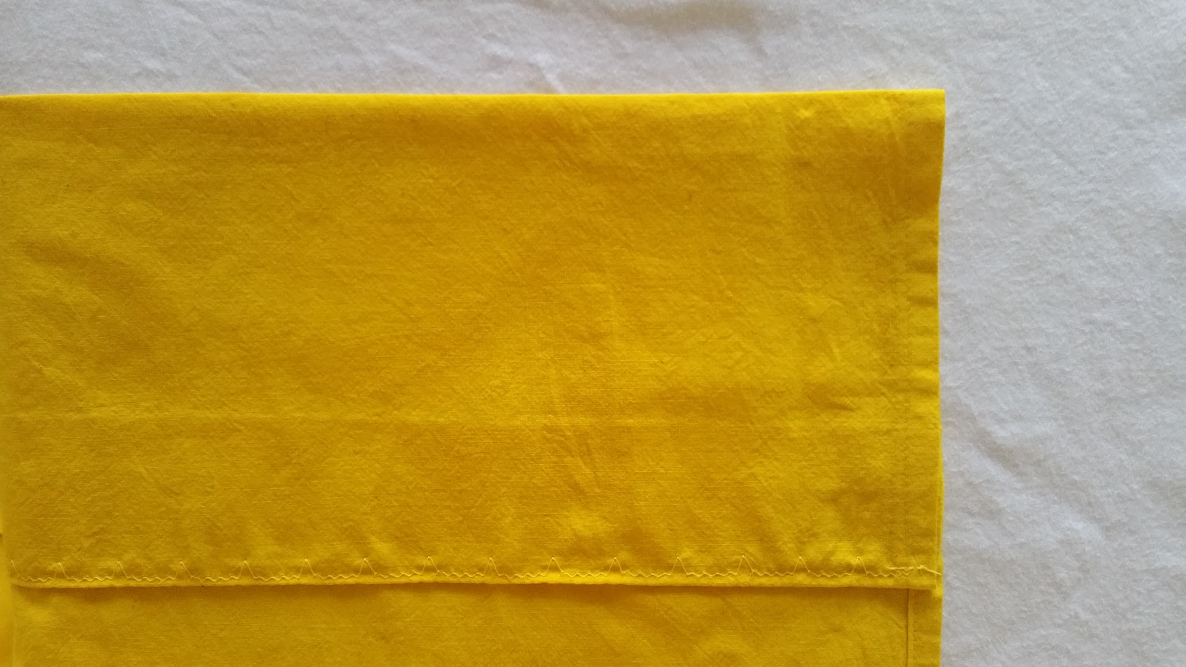
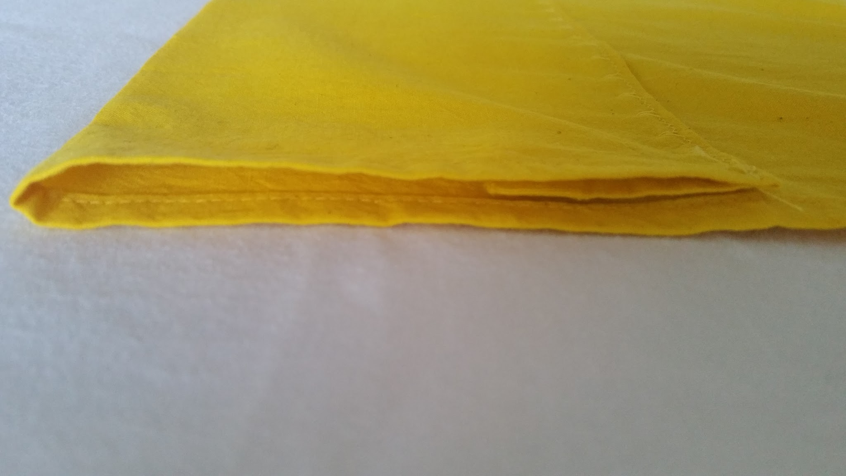
Hemming the Pāʻū
Then fold in extra fabric to create a 5” hem, pin, then sew.
Note: a blind stitch was used in the example below.

Slide 13
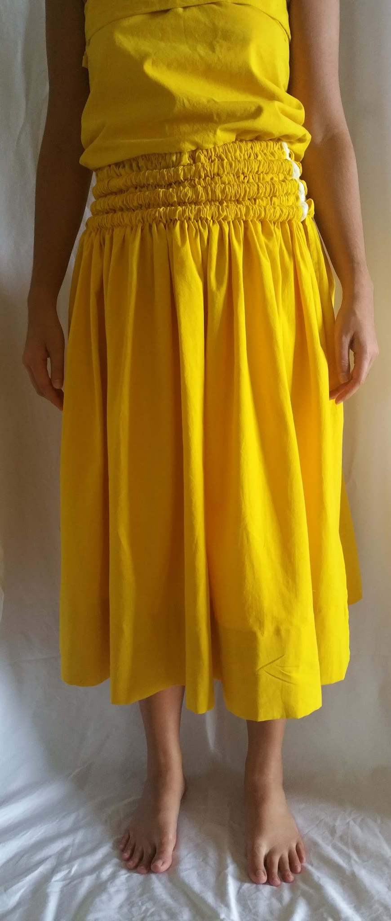
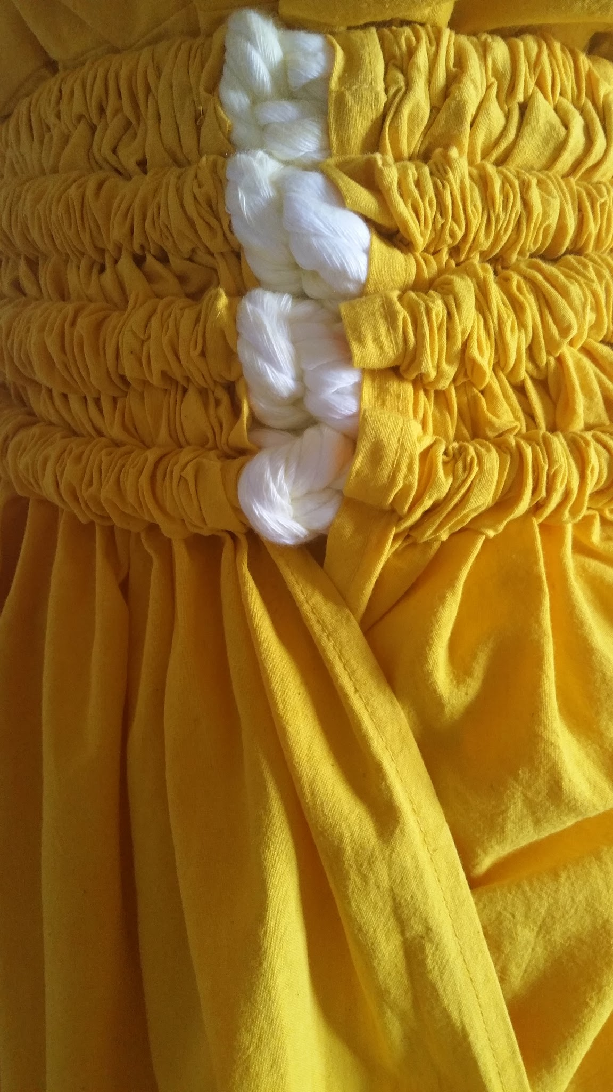
Wearing the Pāʻū
The pāʻū is tied at the waist, with knots on the left side.
Excess cords should be tucked neatly so they do not hang and cannot be seen while dancing.

Slide 14
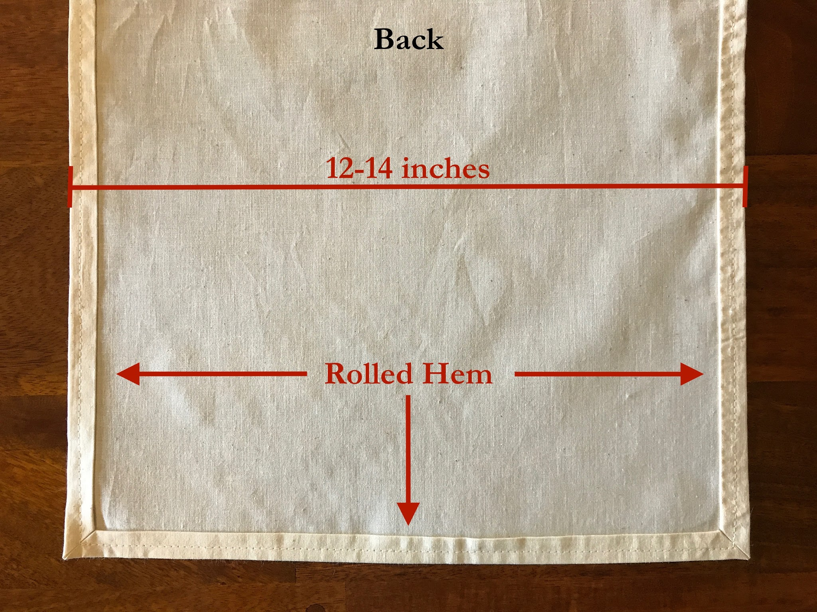
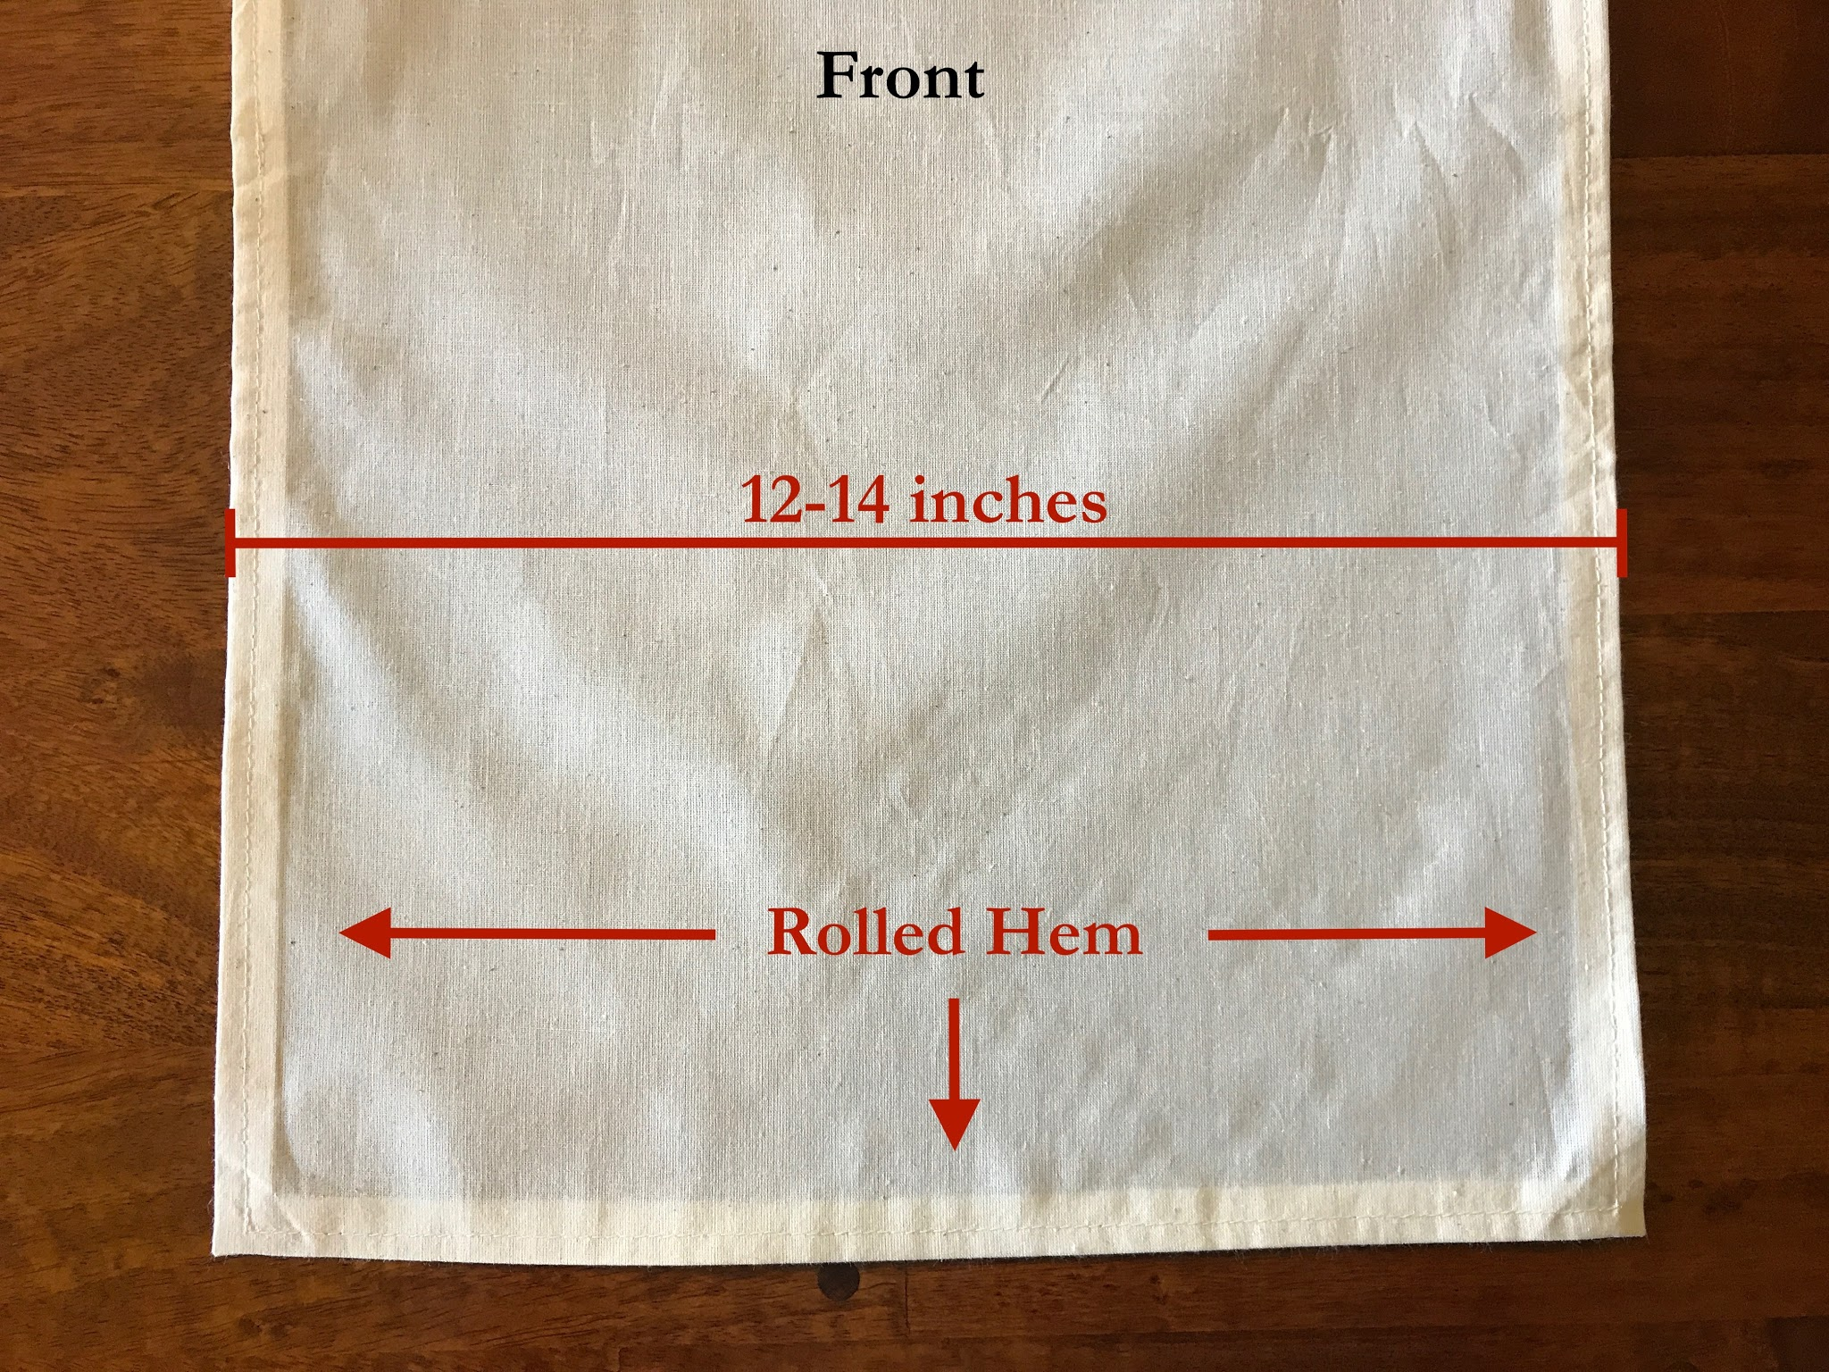
Sewing the Malo
Roll hem all edges of a piece of muslin 6 yards long and about 15” wide. (resulting hemmed width should be 12 to 14 inches)

